Slide 1
Dr. Bahawodin Baha
University of Brighton, UK.
Kabul University, Kabul, Afghanistan January 15th, 2022
Final Year Projects at Universities in the UK

Slide 2
Content
Education system in the UK
Engineering Degree Programmes
Introduction about final year projects
Project process
Project assessment
Project planning
Sample of a project
Project documents
Conclusions

Slide 3
Education in the UK
Age 3.5 to 5, Nursery
School
Key Stage 1: 5 to 7 years old
Key Stage 2: 7 to 11 years old
Key Stage 3: 11 to 14 years old
Key Stage 4: 14 to 16 years old
Course subjects: Math, Science and English language
A-level and Bachelorette
Students for engineering just study Maths, Science and one more subject for two years

Slide 4
Engineering Degree programmes
Most Engineering degree courses are three years in England and four years in Scotland
Accreditation bodies requirements for courses in engineering
According to the accreditation body (the Institution of Engineering and Technology, IET) , the following items must be integrated in every engineering course at universities in the UK.
UNDERPINNING SCIENCE AND MATHEMATICS
ENGINEERING ANALYSIS
DESIGN
ECONOMIC, SOCIAL, AND ENVIRONMENTAL CONTEXT
ENGINEERING PRACTICE
Final year projects are integral part of all engineering courses at universities in the UK
40 credits from total 120 credits.
Final year will count 75% and 2nd year will count 25% in the degree classification.

Slide 5
Project process
Call for projects titles and allocating students to academic staff
Assessment stages
First assessment, project title, aim, objectives of the project finalised (10%), supervisor only
Project organiser select internal examiner for each student
Second assessment just to monitor the progress, supervisor and internal examiner (0%)
Poster display, assessed by supervisor and internal examiner separately (20%)
Students submit their final report, (dissertation, thesis)
Assesses by supervisor and internal examiner separately, (70%)
Final viva is carried out to evaluate the student understanding of the project.

Slide 6
Project Planning

Slide 7
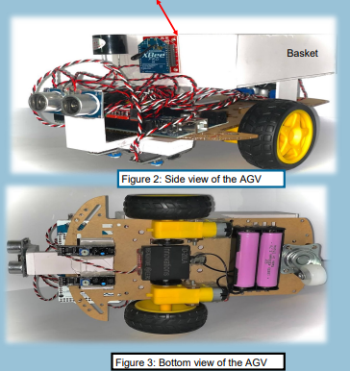
Example of a project: Automated Guided Vehicle (AVG)

Slide 8
Hardware design

Slide 9
Software development

Slide 10
Project documents
Project handbook
Assessment forms and criteria's
Accreditation requirements handbook
Sample of Gannt chart for project planning
A guide how to write the final year project reports
Sample of final reports

Slide 11
Conclusions
Final project is an integral part of most engineering programmes at UK universities
Final year project will provide the students a flavour what to expect when they join the workforce after graduation
Project should have clear aim and objectives
Students should carefully plan their project to achieve the aim and objectives of their projects
The supervisor will guide the students and monitor their progress throughout the project
An independent internal examiner will also help in order to maintain the standards of the projects
Projects are assessed by assessing the final report (dissertation, thesis) and conducting viva to establish if it is the student work or not.

Slide 12
Reflections and possible integration of similar projects at Faculty of Engineering courses
The aim of Engineering Education is to train student who can analyse, design, build and test
Further details will be in the objectives are
The universities in the world train students to achieve the above aim and objectives
The students will be using their analytical skills and knowledge to conduct their projects
Students will also learn other skills such as project planning, communication, coordination, team work
The industry, government and other employers will expect certain knowledge and skills from the university graduates
Off course industry will further train graduates before they join as a junior member in a larger design and other groups.

Slide 13
The End.
Thanks for your attention.
Any Question?

